Slide 1

Live VM Migration
Hwanju Kim

Slide 2
Outline
Live VM migration
Use cases
Live migration mechanisms
Pre-copy live migration
Post-copy live migration
Related research
Energy savings of idle desktops using virtualization
LiteGreen
Jettison
Cloud Micro-Elasticity via VM State Coloring
Kaleidoscope

Slide 3
Live VM Migration

Slide 4










Live VM Migration
Live VM relocation
Lively synchronizing memory contents including CPU states
Storage is shared in LAN (e.g., NAS)
VM
VM
Memory Content
Memory Sync
Configuration Data
User
Network Storage

Slide 5
What is “Live”?
Migration metrics
Total migration time
Time elapsed until all VM states including CPU and memory are transferred
Load is changed (balanced) after this time
Downtime
Time elapsed while a VM is being stopped
Service is unavailable during downtime
What is live migration?
Migration with near-zero downtime

Slide 6

How to Migrate a VM
How to synchronize memory contents?
Stop-and-copy
Stop the source VM
Copy its memory contents over network
Start the destination VM
Pre-copy
Copy memory contents over network
Keep copying only dirty pages iteratively
Stop the source VM if # of dirty pages is under threshold
Copy remaining dirty pages
Start the destination VM
Post-copy
Stop the source VM
Copy CPU states and page tables over network
Start the destination VM
Copy its memory contents on demand
Downtime $∝$ Memory size
Not live!
Near-zero downtime
Live!

Slide 7
Pre-copy vs. Post-copy
Pros and cons
Pre-copy migration | Post-copy migration
Eager copy of source VM’s memory | Lazy copy of source VM’s memory
- Longer and unpredictable downtime depending on writable working set | + Shorter downtime
+ Shorter total migration time | - Longer total migration time
+ High performance after migration | - Low performance after migration due to network page fault
- Waste network bandwidth by pages that will not touched by a destination VM | + Effective use of network bandwidth

Slide 8
Pre-copy vs. Post-copy
Trade-off
Overhead after migration can be effectively reduced by prefetching
Suitable for VM forking and microsleep
Post-copy
Since pre-copy live migration is good for downtime and migration time, it has been used in most VMMs
Total migration time
Pre-copy
Live
Stop-and-copy
Downtime

Slide 9
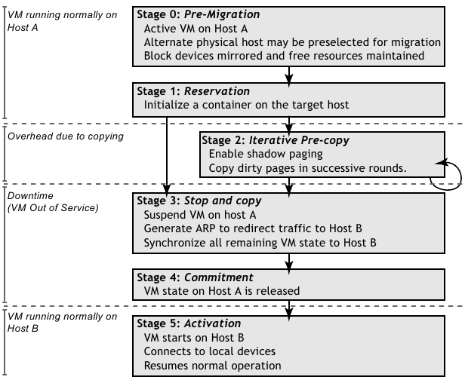
Pre-copy Live Migration
“Live migration of Virtual Machines [NSDI’05]”

Slide 10
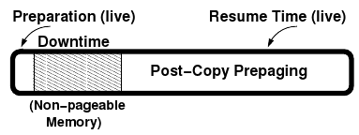
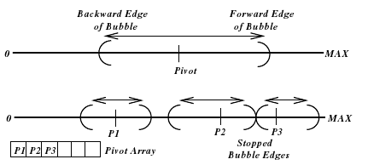
Post-copy Live Migration
“Post-Copy Live Migration of Virtual Machines [VEE’09]”
Main issue: How to reduce runtime overheads after post-copy migration
Prepaging (prefetching) policy
Bubbling with single pivot
Bubbling with multiple pivots

Slide 11
Energy Savings of Idle Desktops Using Virtualization
Related research

Slide 12
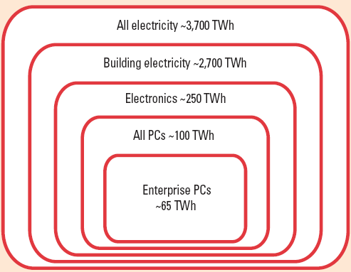
Introduction
How serious is desktop energy consumption?
Source: Greener PCs for the enterprises

Slide 13
Introduction
Why nontrivial for desktop energy savings?
Great savings when away
Users don’t want ongoing jobs
to be disrupted even when away
I’m always
ready!!
VS
Roughly 60% of office desktop
PCs are left on continuously

Slide 14
Naïve Method
Sleep
ACPI S3 and S4 states
S3 – standby (suspend to RAM)
S4 – hibernate (suspend to disk)
Pros.
Significant energy savings
Cons.
Losing network presence
I expect the torrent download to complete after drinking!
So, don’t sleep!!!!
How to save energy with
handling user’s ongoing or potential tasks

Slide 15
Existing Methods
Proxy-based Approach
WoL (Wake-On-Lan) proxy
Same subnet, known MAC addresses, manual operation
Protocol proxy [NSDI‘09, USENIX’10]
Triggered by a filtered subset of the incoming traffic
Listening network ports, user input
Explicit specification before sleep
Application proxy [NSDI‘09]
Application-specific stubs
Complexity for creating each application stub

Slide 16
LiteGreen Project (Mircosoft)
LiteGreen: Saving Energy in Networked Desktops Using Virtualization [USENIX’10]
Achieving the conflicting goals
Energy saving and continuous computing
Eliminating complexity from protocol- or application-specific approaches
locating a desktop in local desktop
for good user experiences
consolidating idle desktops in a server
for energy savings
VM Live
migration!!

Slide 17
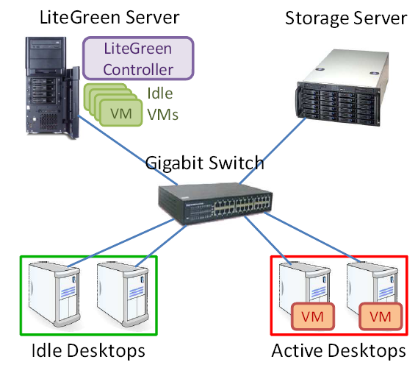
LiteGreen Overview
Architecture

Slide 18

How LiteGreen Works
Operations
LiteGreen Server
VM
VM
VM
Hypervisor
controller
VM
RDP Client
Live migration makes a desktop “always on”
Hypervisor
stub
Desktop

Slide 19

LiteGreen Demo
http://www.youtube.com/watch?v=uHnCiRpfRSs

Slide 20
Problems of Full VM Migration
Excessive network bandwidth for migration
VM memory size + alpha (dirty block copies)
e.g., about 4.27GB for 4GB VM
“Boot storm” (after lunch)
Long migration time
Delayed sleep
e.g., 38sec for 1VM, 253sec for 8 VMs
Less energy savings
Full VM migration after ballooning → ballooning requires considerable time and I/O
Consolidation aborted by short idle time
Long resume time
Poor user experience

Slide 21
Jettison
Jettison: Efficient Idle Desktop Consolidation with Partial VM Migration [EuroSys’12]
Goals
Quick resume
Good user experience
Conservation of the network resources
Efficiency and scalability
Cost effective
Reduction in TCO by energy savings
Idea
“Partial VM migration” with fetching required parts on demand

Slide 22
Partial VM Migration
Jettison
Procedure
1. Idleness detection
2. Consolidation
Jettison Server
3. Microsleep
VM
VM
VM
4. On-demand fetch
5. Reintegration
Hypervisor
controller
Wake-on-LAN
VM
VM
Sleep
(S3)
Hypervisor
stub
Desktop

Slide 23
State Prefetch
Prefetch for increasing inter-arrivals of remote faults
Hoarding
Based on fetched frame sequence of a previous migration
On-demand prefetch
Based on spatial locality

Slide 24
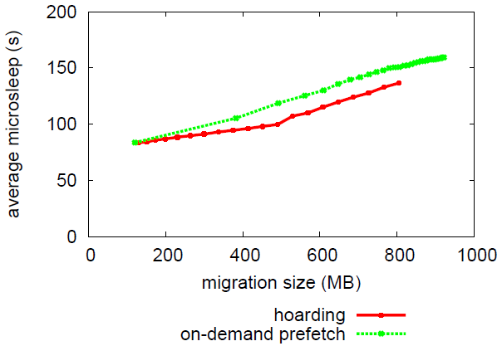
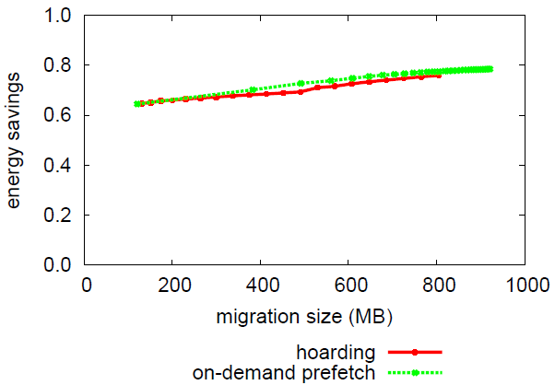
State Prefetch
Trace-driven offline analysis
Page access traces from a user VM consolidated 58 times
On-demand prefetch works well with 20 page window

Slide 25
Budget Analysis
Full vs. Parital VM migration
Assuming 16GiB memory SunFire X2250
USD 6099
Full VM migration
33.95 USD / desktop / year
33.95 x 4 VMs x 3 years = USD 407.40
Partial VM migration
37.35 USD / desktop / year
37.35 x 98 VMs x 3 years = USD 10,980.90

Slide 26
Kaleidoscope: Cloud Micro-Elasticity via VM State Coloring
Related Research

Slide 27
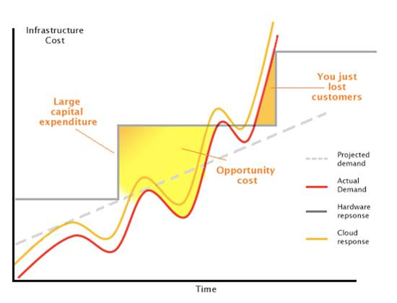
Elasticity of Clouds
Ideal elasticity: Pay-per-use model
Achieves both QoS and efficient resource utilization
Source: http://astadiaemea.wordpress.com/2010/06/

Slide 28
What Matters for Elasticity?
Granularity
A unit of service delivery and billing
VM as a unit
IaaS (e.g., Amazon EC2)
Coarse granularity
A VM booting from scratch
QoS
Well-known trade-off against resource utilization
Conservative elasticity
High QoS, but inefficient resource utilization
Aggressive elasticity
Low QoS, but efficient resource utilization
Too slow for ideal elasticity
Ideal Cloud!
How about QoS?

Slide 29
QoS in Clouds
Dynamic adjustment of worker VM pool
Amazon EC2
Auto Scaling
Elastic Load Balancing
Load balancing using elasticity
Load > T_{H}
Inflate VM pool by requesting additional VMs
Load < T_{L}
Deflate VM pool by returning unnecessary VMs
High threshold
Achieves aggressive elasticity for efficient resource utilization
Requires fast VM instantiation for QoS

Slide 30
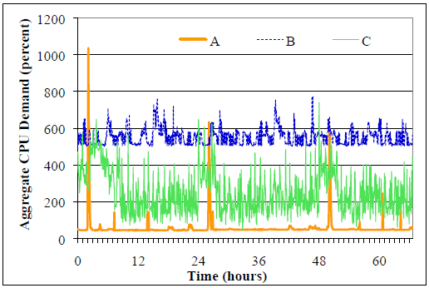
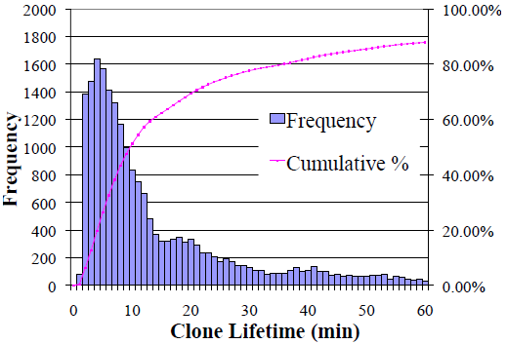
Elasticity Needs
AT&T’s hosting in January 2010
Needs for elasticity
Short-lived workers

Slide 31
Problems of Current Clouds
Slow VM instantiation
Average 2min to boot a VM (Amazon EC2)
Very fluctuating latencies
Cold status of new VMs
Initially empty OS caches
Performance degradation during peak load
Inefficient resource utilization of new VMs
Full memory allocation during short-lived VMs that require smaller working set

Slide 32
Micro-Elasticity
Goals
Fast VM instantiation
VM cloning: SnowFlock [Eurosys’09]
Efficient memory utilization for short-lived VM
On-demand resource allocation
Warm status of new VMs
Prefetching related data: VM state coloring
Color-based fractional VM cloning

Slide 33
Live VM Cloning
Trade-off between cloning techniques
Post-copy cloning | Pre-copy cloning
SnowFlock [EuroSys’09] | Like live migration
Lazy copy of parent’s memory | Eager copy of parent’s memory
Short cloning time | Long and unpredictable cloning time
Low performance after cloning due to the cold status | High performance after cloning due to the warm status
Effective use of network bandwidth & Possibility of memory savings | Waste of memory and network bandwidth by pages that will not touched by clone VMs

Slide 34

VM State Coloring
Effective VM memory prefetching scheme
Assuming that locality exist within a related region
Partitioning VM memory into semantically related regions
Methods
Architecture-based coloring
Introspective coloring
VM memory
=
Uniform binary state
VM state coloring

Slide 35
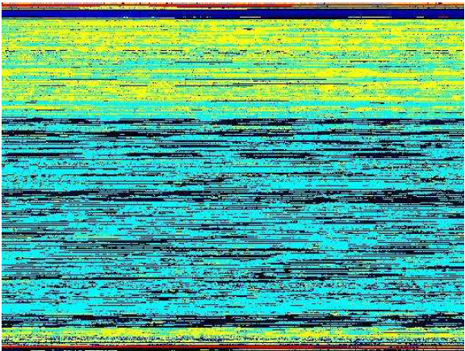
VM State Coloring
Color map example
SPECweb Support workload
Interspersing of different colors in the physical memory space of the VM
Yello –page cache
Light blue – user data
Dark blue – kernel data
Light red – user code
Dark red – kernel code
Black - free

Slide 36
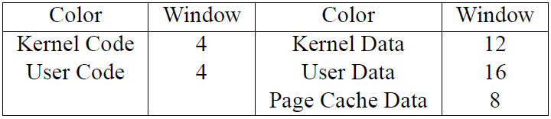
VM State Coloring
Benefits of per-color prefetching against color-blind prefetching
Accuracy
Fewer wasted fetches of unneeded pages
Efficiency
Less page faults
Per-color prefetch tuning

Slide 37
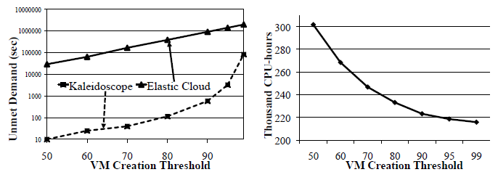
Implications for Clouds
QoS and resource use
Kaleidoscope with TH=90% outperforms Elastic Clouds with TH=50%

Slide 38
Summary
Live migration is a key technique of virtualization
Pre-copy live migration
Working well for general workloads
No performance degradation after migration
Used by most VMMs
Post-copy live migration
On-demand migration
Efficient bandwidth usage
Strong for write-intensive workloads
Assisted by prefetching

